Slide 1

CPS3123 - Lecture 3
Node Fundamentals - Part 2

Slide 2
Topics
Javascript Refresher
JSON Object
Node Fundamentals - Part 2
Asynchronous Code, Libuv and Event Loop
Buffers and Streams
Files and fs

Slide 3
JSON Object
JSON stands for JavaScript Object Notation
It is a light-weight data interchange format. Easy for humans to read and write and for machines to parse and generate.
It is based on subset of JavaScript Programming Language (ECMAScript 3)
http://www.json.org/

Slide 4
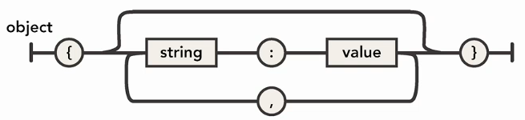
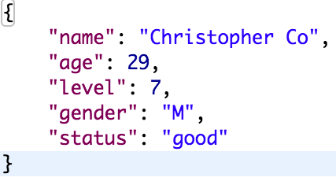
JSON Format
JSON is built on two structures:
A collection of name/value pairs
An ordered list of values ie. an array

Slide 5
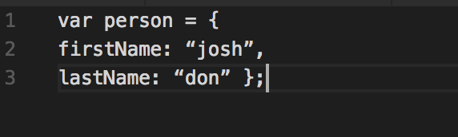
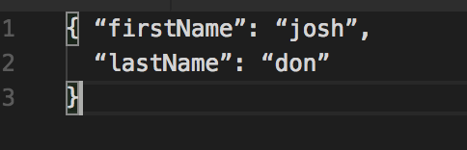
Javascript Object Literal vs JSON Object
The syntax is very similar.
The only difference is that the names in JSON object must be wrapped in double quotes.
Javascript Object Literal
JSON Object

Slide 6
Asynchronous Code, Libuv and Event Loop

Slide 7
The Event Loop
The event loop is what allows Node.js to perform non-blocking I/O operations.
Since most modern kernels are multi-threaded they can handle multiple operations in the background.
** In the Browser, the event loop is constantly listening to DOM events, such as key presses and mouse clicks.

Slide 8
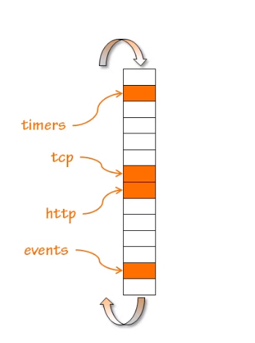
Nodes Event Loop
Nodes Event Loop is constantly listening for events on the server side.
These events can be externally generated such as http requests or tcp connections.
They can be internal events generated by your application such as Timers

Slide 9
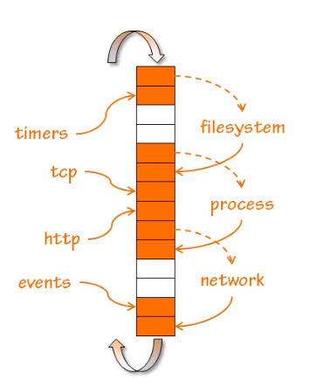
Nodes Event Loop
Other events may triggered as a result of a response to external event.
ie. Requesting Node to open file for reading will trigger event when completed.
All these events will be handled asynchronously.

Slide 10
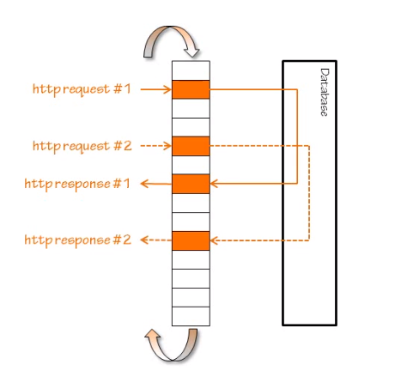
Web Application example for non-blocking approach
Application raises an http request, which triggers an event to read a query from database.
Once Node receives event from database it is complete it sends back response.
While waiting, Node is not blocked and free to handle additional requests.

Slide 11
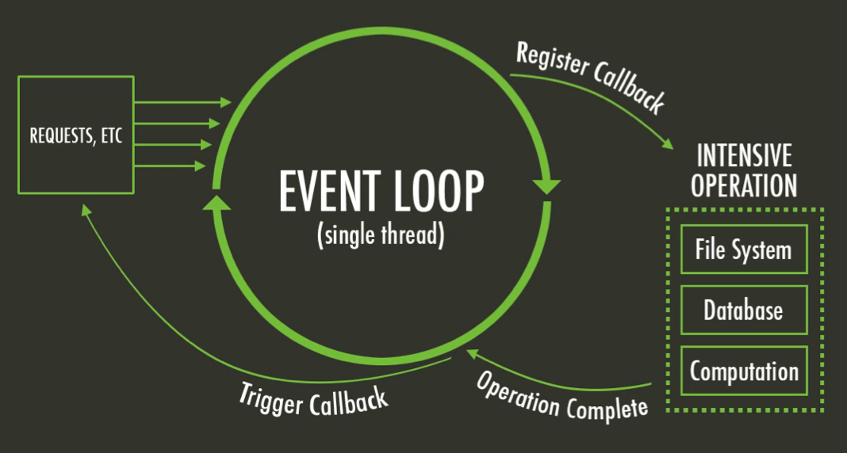

Slide 12
Async I/O
The following tasks should be done asynchronously using the event loop:
I/O operations
Heavy computation
Anything requiring blocking

Slide 13
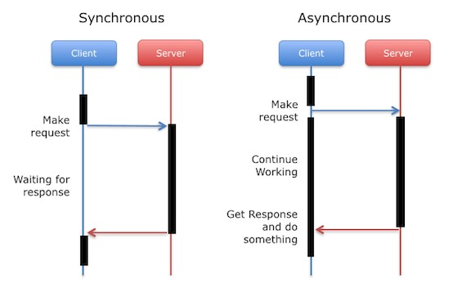
Asynchronous vs Synchronous programmimg

Slide 14
What is a callback ?
A callback is a function that is to be executed after another function has finished executing - hence the name ‘call back’
An event is like a broadcast, while a callback is like a handshake.
A component that raises an event knows nothing about its client, while a component that uses a callback knows a great deal.

Slide 15
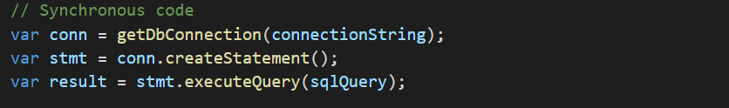
Asynchronous vs Synchronous code

Slide 16
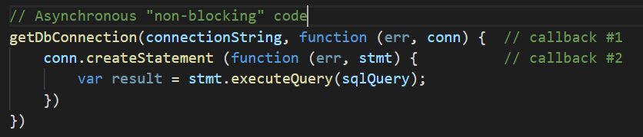
Asynchronous vs Synchronous code

Slide 17

libuv - (Unicorn Velociraptor Library)
A multi-platform C library that provides support for asynchronous I/O based on event loops.

Slide 18
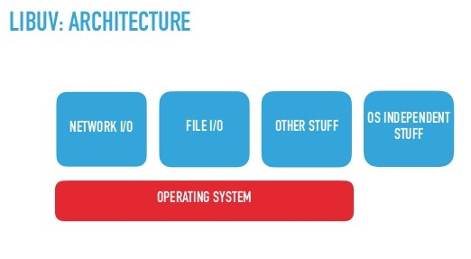
libuv

Slide 19
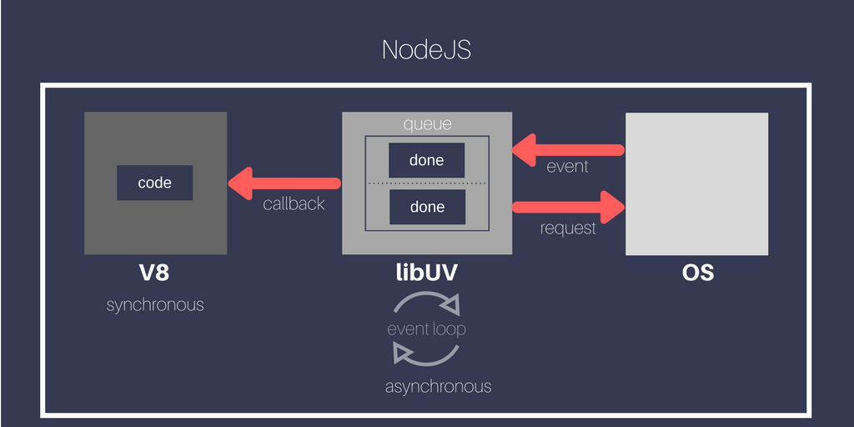

Slide 20
Buffers and Streams

Slide 21
Buffer
A temporary holding spot for data being moved from one place to another.
The buffer is filled with data, then passed along
Transfer small chunks of data at a time without waiting for whole data to download. ie. Youtube video

Slide 22
Buffer
A buffer is a raw set of data from memory with no defined type. That means it can be anything:
Text file
Video
Image
An array

Slide 23
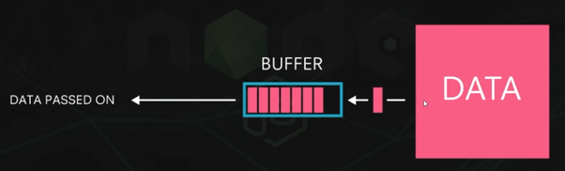
Buffer

Slide 24
Streams
Stream is just a process of flow of data from the data source to the buffer and from the buffer to the client.
All these data ‘chunks’ flow in a stream to transfer data
Used to increase performance

Slide 25
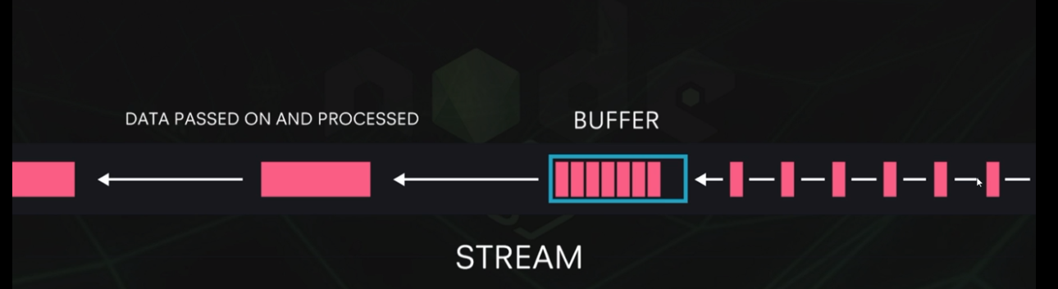
Streams

Slide 26
Files and fs

Slide 27
Streams
Streams are instance of and extensions to the EventEmitter
Used for managing data flow, including
Network traffic (http requests & responses, tcp sockets)
File I/O
stdin/stdout/stderr
Streams can be either readable, writable or both!

Slide 28
Streams
Writable streams - can write data to a stream
Readable streams - can read data from a stream
Duplex - can read and write to a stream

Slide 29
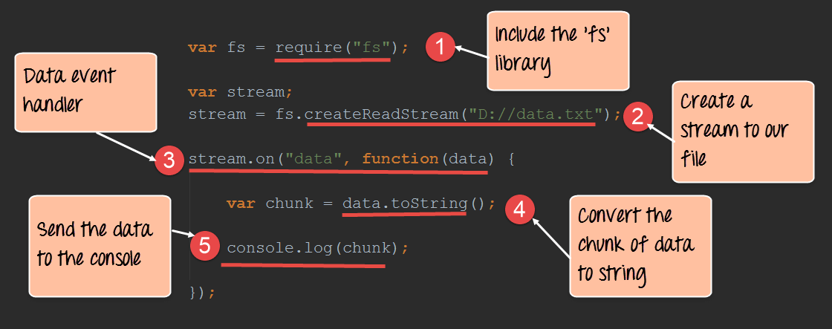
Creating Readable Stream

Slide 30
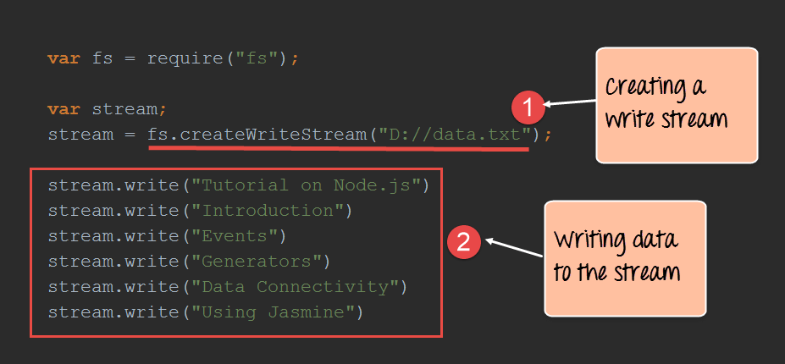
Creating Writable Stream

Slide 31
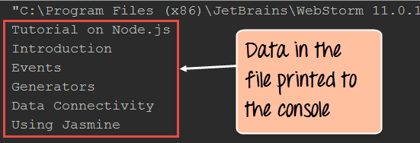
Output from Writable Stream

Slide 32
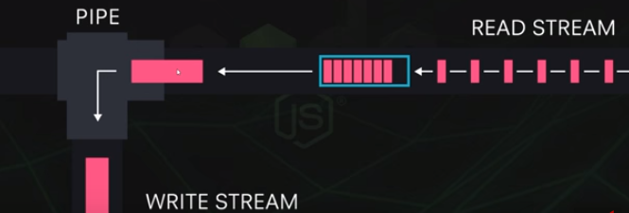
Pipe

Slide 33
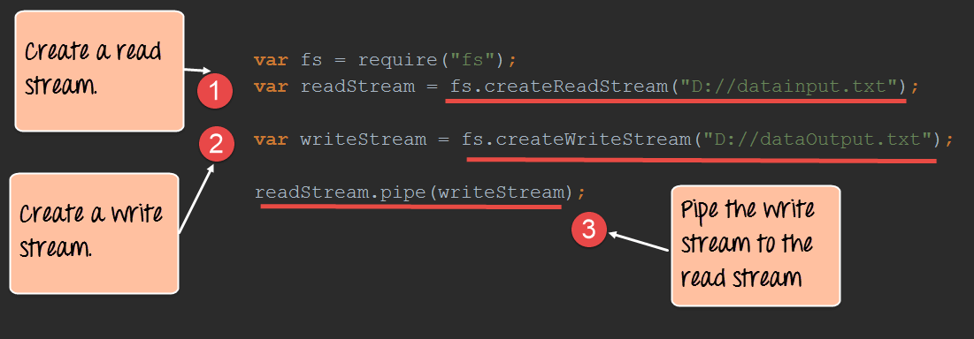
Piping between two streams

Slide 34
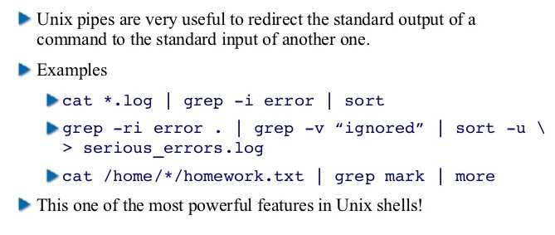
Nodejs through Libuv is using the old UNIX commands

